Slide 1
ECE408/CS483/CSE408 Fall 2017
Convolution Layer Optimization
Carl Pearson
pearson@Illinois.edu

Slide 2
Sequential Code Convolution Layer Forward Path
void convLayer_forward(int B, int M, int C, int H, int W, int K, float* X, float* W, float* Y) {
int H_out = H – K + 1;
int W_out = W – K + 1;
for (int b = 0; b < B; ++b) // for each image in batch
for(int m = 0; m < M; m++) // for each output feature map
for(int h = 0; h < H_out; h++) // for each output element
for(int w = 0; w < W_out; w++) {
Y[b, m, h, w] = 0;
for(int c = 0; c < C; c++) // sum over all input feature maps
for(int p = 0; p < K; p++) // KxK filter
for(int q = 0; q < K; q++)
Y[b, m, h, w] += X[b, c, h + p, w + q] * W[m, c, p, q];
}
}

Slide 3
Image b in mini batch
1 | 2 | 0 | 1
1 | 1 | 3 | 2
0 | 2 | 2 | 0
2 | 1 | 0 | 3
A Small Convolution Layer Example
1 | 1 | 1
2 | 2 | 3
2 | 1 | 0
X[b,0,_, _]
W[0,0,_, _]
0 | 2 | 1 | 0
0 | 3 | 2 | 1
1 | 1 | 0 | 2
2 | 1 | 0 | 3
1 | 2 | 3
1 | 1 | 0
3 | 0 | 1
0 | ?
? | ?
input channel
W[0,1,_, _]
Y[b,0,_, _]
X[b,1,_, _]
X[0,_,_]
W[0,1,_, _]
0 | 1 | 1
1 | 0 | 2
1 | 2 | 1
1 | 2 | 1 | 0
0 | 1 | 3 | 2
3 | 3 | 2 | 0
1 | 3 | 2 | 0
W[0,2,_, _]
Y[0,_, _]
X[b,2,_, _]
output channel

Slide 4
1 | 2 | 0 | 1
1 | 1 | 3 | 2
0 | 2 | 2 | 0
2 | 1 | 0 | 3
A Small Convolution Layer Example
c = 0
1 | 1 | 1
2 | 2 | 3
2 | 1 | 0
X[b,0,_, _]
W[0,0,_, _]
3+13+2
0 | 2 | 1 | 0
0 | 3 | 2 | 1
1 | 1 | 0 | 2
2 | 1 | 0 | 3
1 | 2 | 3
1 | 1 | 0
3 | 0 | 1
18 | ?
? | ?
W[0,1,_, _]
X[b,1,_, _]
Y[b,0,_, _]
0 | 1 | 1
1 | 0 | 2
1 | 2 | 1
1 | 2 | 1 | 0
0 | 1 | 3 | 2
3 | 3 | 2 | 0
1 | 3 | 2 | 0
W[0,2,_, _]
X[b,2,_, _]

Slide 5
1 | 2 | 0 | 1
1 | 1 | 3 | 2
0 | 2 | 2 | 0
2 | 1 | 0 | 3
A Small Convolution Layer Example
c = 1
1 | 1 | 1
2 | 2 | 3
2 | 1 | 0
X[b,0,_, _]
W[0,0,_, _]
… 18+
7+3+3
0 | 2 | 1 | 0
0 | 3 | 2 | 1
1 | 1 | 0 | 2
2 | 1 | 0 | 3
1 | 2 | 3
1 | 1 | 0
3 | 0 | 1
31 | ?
? | ?
W[0,1,_, _]
X[b,1,_, _]
Y[b,0,_, _]
0 | 1 | 1
1 | 0 | 2
1 | 2 | 1
1 | 2 | 1 | 0
0 | 1 | 3 | 2
3 | 3 | 2 | 0
1 | 3 | 2 | 0
W[0,2,_, _]
X[b,2,_, _]

Slide 6
1 | 2 | 0 | 1
1 | 1 | 3 | 2
0 | 2 | 2 | 0
2 | 1 | 0 | 3
A Small Convolution Layer Example
c = 2
1 | 1 | 1
2 | 2 | 3
2 | 1 | 0
X[b,0,_, _]
W[0,0,_, _]
… 31+
3+6+11
0 | 2 | 1 | 0
0 | 3 | 2 | 1
1 | 1 | 0 | 2
2 | 1 | 0 | 3
1 | 2 | 3
1 | 1 | 0
3 | 0 | 1
51 | ?
? | ?
W[0,1,_, _]
X[b,1,_, _]
Y[b,0,_, _]
0 | 1 | 1
1 | 0 | 2
1 | 2 | 1
1 | 2 | 1 | 0
0 | 1 | 3 | 2
3 | 3 | 2 | 0
1 | 3 | 2 | 0
W[0,2,_, _]
X[b,2,_, _]

Slide 7
Parallelism in a Convolution Layer
All output feature maps can be calculated in parallel
  Usually a small number, not sufficient to fully utilize a GPU
All output feature map pixels can be calculated in parallel
  All rows can be done in parallel
  All pixels in each row can be done in parallel
  Large number but diminishes as we go into deeper layers
All input feature maps can be processed in parallel, but will need atomic operation or tree reduction

Slide 8
Design of a Basic Kernel
Each block computes a tile of output pixels
  TILE_WIDTH pixels in each dimension
The first (x) dimension in the grid maps to the M output feature maps
The second (y) dimension in the grid maps to the tiles in the output feature maps

Slide 9
Host Code for a Basic Kernel: CUDA Grid
W_out and H_out are the output feature map width and height
# define TILE_WIDTH 16 // We will use 4 for small examples.
W_grid = W_out/TILE_WIDTH; // number of horizontal tiles per output map
H_grid = H_out/TILE_WIDTH; // number of vertical tiles per output map
Y = H_grid * W_grid;
dim3 blockDim(TILE_WIDTH, TILE_WIDTH, 1);
dim3 gridDim(M, Y, 1);
ConvLayerForward_Kernel<<< gridDim, blockDim>>>(…);

Slide 10
CUDA Grid and Threadblocks
A Small Example
Assume 4 output feature maps (M = 4)
  Each output feature map is 8x8 image (W_out = H_out = 8)
  We have 4 blocks in the x dimension
If we use tiles of 4 pixels on each side (TILE_SIZE = 4)
  We have 4 blocks in the x dimension
    Top two blocks in each column calculates the top row of tiles in the corresponding output feature map
    Bottom two block in each column calculates the bottom row of tiles in the corresponding output feature map
Output Feature Maps and Tiles

Slide 11
A Basic Conv. Layer Forward Kernel (Code is Incomplete!)
__global__ void ConvLayerForward_Basic_Kernel(int C, int W_grid, int K,
float* X, float* W, float* Y)
{
int m = blockIdx.x;
int h = blockIdx.y / W_grid + threadIdx.y;
int w = blockIdx.y % W_grid + threadIdx.x;
float acc = 0.;
for (int c = 0; c < C; c++) { // sum over all input channels
for (int p = 0; p < K; p++) // loop over KxK filter
for (int q = 0; q < K; q++)
acc += X[c, h + p, w + q] * W[m, c, p, q];
}
Y[m, h, w] = acc;
}

Slide 12
Some Observations
The amount of parallelism is quite high as long as the total number of pixels across all output feature maps is large
  This matches the CNN architecture well
Each input tile is loaded multiple times, once for each block that calculates the output tile that requires the input tile
  Not very efficient in global memory bandwith

Slide 13
Sequential Code for the Forward Path of a Subsampling Layer
void poolingLayer_forward(int M, int H, int W, int K, float* Y, float* S)
{
for(int m = 0; m < M; m++) // for each output feature maps
for(int h = 0; h < H/K; h++) // for each output element
for(int w = 0; w < W/K; w++) {
S[m, x, y] = 0.;
for(int p = 0; p < K; p++) { // loop over KxK input samples
for(int q = 0; q < K; q++)
S[m, h, w] += Y[m, K*h + p, K*w + q] /(K*K);
}
// add bias and apply non-linear activation
S[m, h, w] = sigmoid(S[m, h, w] + b[m])
}
}

Slide 14
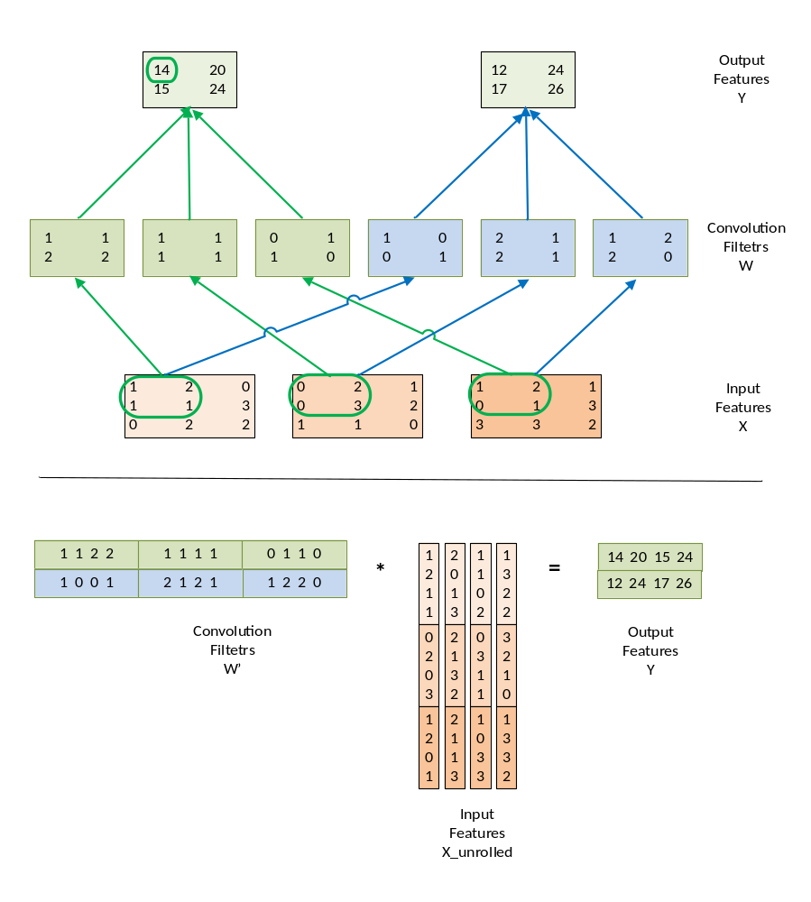
Implementing a Convolution Layer with Matrix Multiplication

Slide 15
Function to generate “unrolled” X
void unroll(int B, int C, int H, int W, int K, float *X, float *X_unroll) {
int H_out = H – K + 1;
int W_out = W – K + 1;
for (int b = 0; b < B; ++b)
for (int c = 0; c < C; ++c) {
int w_base = c * (K*K);
for (int p = 0; p < K; ++p)
for (int q = 0; q < K; ++q) {
for (int h = 0; h < H_out; ++h)
for (int w = 0; w < W_out; ++w) {
int w_unroll = w_base + p * K + q;
int h_unroll = h * W_out + w;
X_unroll[b, h_unroll, w_unroll] = X[b, c, h + p, w + q];
}
}
}

Slide 16
Simple Matrix Multiplication
1 | 2 | 1 | 1
2 | 0 | 1 | 3
1 | 1 | 0 | 2
1 | 3 | 2 | 2
0 | 2 | 0 | 3
2 | 1 | 3 | 2
0 | 3 | 1 | 1
3 | 2 | 1 | 0
1 | 2 | 1 | 1
2 | 1 | 0 | 3
0 | 1 | 3 | 3
1 | 3 | 3 | 2
0
Each product matrix element is an output feature map pixel.
This inner product generates element 0 of output feature map 0.
Input feature maps
1
2
Convolution Filters
0
1 | 1 | 2 | 2 | 1 | 1 | 1 | 1 | 0 | 1 | 1 | 0
1 | 0 | 0 | 1 | 2 | 1 | 2 | 1 | 1 | 2 | 2 | 0
14 | 20 | 15 | 24
12 | 24 | 17 | 26

Slide 17
Tiled Matrix Multiplication
2x2 Example
1 | 2 | 1 | 1
2 | 0 | 1 | 3
1 | 1 | 0 | 2
1 | 3 | 2 | 2
0 | 2 | 0 | 3
2 | 1 | 3 | 2
0 | 3 | 1 | 1
3 | 2 | 1 | 0
1 | 2 | 1 | 1
2 | 1 | 0 | 3
0 | 1 | 3 | 3
1 | 3 | 3 | 2
0
Each block calculates one output tile – 2 elements from each output map
Each input element is reused 2 times in the shared memory
Input feature maps
1
2
Convolution Filters
0
1 | 1 | 2 | 2 | 1 | 1 | 1 | 1 | 0 | 1 | 1 | 0
1 | 0 | 0 | 1 | 2 | 1 | 2 | 1 | 1 | 2 | 2 | 0
14 | 20 | 15 | 24
12 | 24 | 17 | 26
1

Slide 18
Tiled Matrix Multiplication
2x4 Example
1 | 2 | 1 | 1
2 | 0 | 1 | 3
1 | 1 | 0 | 2
1 | 3 | 2 | 2
0 | 2 | 0 | 3
2 | 1 | 3 | 2
0 | 3 | 1 | 1
3 | 2 | 1 | 0
1 | 2 | 1 | 1
2 | 1 | 0 | 3
0 | 1 | 3 | 3
1 | 3 | 3 | 2
0
Each block calculates one output tile – 4 elements from each output map
Each input element is reused 2 times in the shared memory
Input feature maps
1
2
Convolution Filters
0
1 | 1 | 2 | 2 | 1 | 1 | 1 | 1 | 0 | 1 | 1 | 0
1 | 0 | 0 | 1 | 2 | 1 | 2 | 1 | 1 | 2 | 2 | 0
14 | 20 | 15 | 24
12 | 24 | 17 | 26
1

Slide 19
Efficiency Analysis: Total Input Replication
Replicated input features are shared among output maps
  There are H_out * W_out output feature map elements
  Each requires K*K elements from the input feature maps
  So, the total number of input element after replication is H_out*W_out*K*K times for each input feature map
  The total number of elements in each original input feature map is
  (H_out+K-1) * (W_out+K-1)

Slide 20
Analysis of a Small Example
H_out = 2
W_out = 2
K = 2
There are 3 input maps (channels)
The total number of input elements in the replicated (“unrolled”) input matrix is 3*2*2*2*2
The replicating factor is
(3*2*2*2*2)/(3*3*3) = 1.78

Slide 21
Memory Access Efficiency of Original Convolution Algorithm
Assume that we use tiled 2D convolution
For input elements
  Each output tile has TILE_WIDTH² elements
  Each input tile has (TILE_WIDTH+K-1)²
  The total number of input feature map element accesses was TILE_WIDTH²*K²
  The reduction factor of the tiled algorithm is K²*TILE_WIDTH²/(TILE_WIDTH-K+1)²
The convolution filter weight elements are reused within each output tile

Slide 22
Efficiency of Tiled Matrix Multiplication
Assuming we use TILE_WIDTH² input and output tiles
  Each replicated input feature map element is reused TILE_WIDTH times
  Each convolution filter weight element is reused TILE_WIDTH times
  Matrix multiplication better if TILE_WIDTH is larger than K²*TILE_WIDTH²/(TILE_WIDTH-K+1)²

Slide 23
Problem with Later Stages
The size (H_out, W_out) of each output feature map decreases as we go to the later stages of the CNN
  The TILE_WIDTH may be limited to very small sizes relative to K
  The benefit of 2D tiling will diminish as we go down the pipeline
  This is an intrinsic problem for 2D tiled convolution

Slide 24
Tile Matrix Multiplication: More Stable Performance for Different Sizes
The filter matrix is an M x C*K*K matrix.
The expanded input feature map matrix is a C*K*K x H_out*W_out matrix.
Except for the height of the filter-bank matrix, the sizes of all dimensions depend on products of the parameters to the convolution, not the parameters themselves.
While individual parameters can be small, their products tend to be large.
  The amount of work for each kernel launch will remain large as we go to the later stages of the CNN

Slide 25
Some other Optimizations
Use streams to overlap the reading of the next set of input feature maps with the processing of the previous input feature maps.
Create unrolled matrix elements on the fly, only when they are loaded into shared memory
Use more advanced algorithms such as FFT to implement convolution

