Slide 1
Feed-Forward Networks and
Gradient-Based Training
ECE408 / CS483 / CSE 408
Fall 2017
Carl Pearson
pearson@illinois.edu

Slide 2
Recap: Machine Learning
An important way of building applications whose logic is not fully understood.
  Use labeled data – data that come with the input values and their desired output values – to learn what the logic should be
  Capture each labeled data item by adjusting the program logic
  Learn by example!

Slide 3
Machine Learning Tasks (1)
Classification
  Which of k categories an input belongs to
  Ex: object recognition
Regression
  Predict a numerical value given some input
  Ex: predict tomorrow’s temperature
Transcription
  Unstructured data into textual form
  Ex: optical character recognition

Slide 4
Machine Learning Tasks (2)
Translation
  Convert a sequence of symbols in one language to a sequence of symbols in another
Structured Output
  Convert an input to a vector with important relationships between elements
  Ex: natural language sentence into a tree of grammatical structure
Others
  Anomaly detection, synthesis, sampling, imputation, denoising, density estimation

Slide 5
Why Machine Learning Now?
GPU computing hardware and programming interfaces such as CUDA has enabled very fast research cycle of deep neural net training
Computer Vision, Speech Recognition, Document Translation, Self Driving Cars, Data Science…
Most involve logic that were previously not effectively constructed with imperative programming
Using big labeled data to train and specialize DNN based classifiers
  Deriving a large quantity of quality labeled data is a challenge

Slide 6
Classification
Formally: a function that maps an input to k categories
f : R^{n} → {1, …, k},
Our formulation: a function f parameterized by ϴ that maps input vector x to numeric code y
y = f(x, ϴ)
ϴ encapsulates the structure and weights in our network

Slide 7
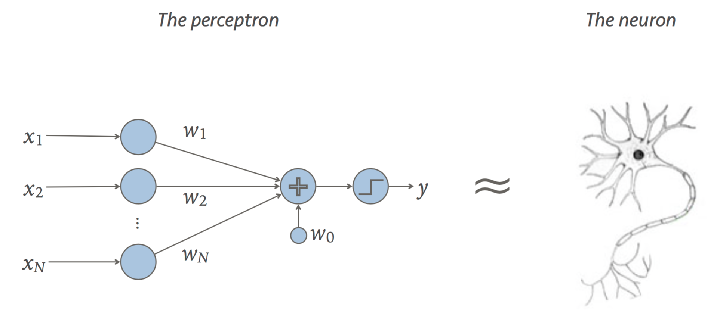

Linear Classifier (Perceptron)
Recall our formulation:
Dot product:
Scalar addition:
y = f(x, ϴ)
y = sign(W • x + b)
ϴ = {W, b}
output
y = W • x
input
+ b
weight
bias

Slide 8
Multi-Layer Perceptron
What if a linear classifier can’t learn a function?
XOR
AND
OR
?
=
+

Slide 9
Multi-Layer Perceptron
XOR
AND
OR
?
=
+
A | B | OR | AND | XOR
0 | 0 | -1 | -1 | -1
0 | 1 | 1 | -1 | 1
1 | 0 | 1 | -1 | 1
1 | 1 | 1 | 1 | -1

Slide 10
A | B | OR | AND | XOR
0 | 0 | -1 | -1 | -1
0 | 1 | 1 | -1 | 1
1 | 0 | 1 | -1 | 1
1 | 1 | 1 | 1 | -1
AND = sign(x₁ + x₂ - 1.5)
XOR = sign(AND-2 * OR - 2)
OR = sign(x₁ + x₂ - 0.5)
OR Perceptron
x₁
1
+
1
x₂
1
-0.5
+
y
x₁
1
+
-2
-2
x₂
1
-1.5
AND Perceptron

Slide 11
Multilayer Terminology
x₁ x₂ x₃ x₄
Input Layer
[4x4] W₁
W_{i,j} is weight between i^{th} input and j^{th} output
Hidden Layer(s)
[4x3] W₂
Output Layer
k₁ k₂ k₃
Argmax
y

Slide 12
How to determine the weights?
Fully connected layer with 784 inputs, 1024 outputs:
  [784 x 1024] weight matrix
  [1024 x 1] bias vector
Look at observational data to determine the weights.
With enough input data and corresponding desired outputs, we can model the relationship between inputs and outputs.

Slide 13
Forward and Backward Propagation
Forward (inference)
  Given parameters ϴ and input x, produce label y
Backward (training)
  Given input data and target label t, determine ϴ

Slide 14
Ingredients for Gradient-Based Supervised Training
One labeled dataset (large)
  Example: 60,000 28x28 grayscale images of handwritten numbers, each labeled
One network architecture
  Example: perceptron
  y = W • x + b
One error function
  For target label t, network output y,
  Example: E = ½ (y – t)²
Recall: ϴ = {W, b}

Slide 15
Gradient-Based Training Outline
(Stochastic Gradient Descent)
For each labeled image:
  Read data to initialize input layer
  Evaluate network to get y (forward)
  Compare with target label t to get error E
  Backpropagate error derivative to get parameter updates
  Adjust parameters ϴ in a direction that reduces total E over entire training set.
    ϴ_{i+1} = ϴ_{i} - εΔϴ
Each gradient update happens from most accurate minima estimation

Slide 16
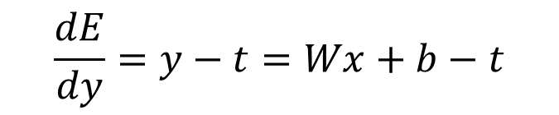
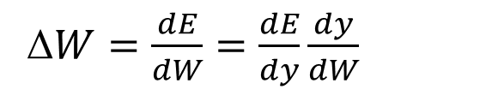

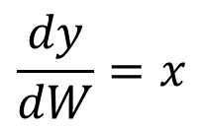
Computing the Gradient Update
ϴ_{i+1} = ϴ_{i} - εΔϴ
W_{i+1} = W_{i} - εΔW
Parameter Update
y = W • x + b
Network function
$$\frac{dy}{dW}=x$$
Network weight gradient
E = ½ (y – t)²
Error function
$$\frac{dE}{dy}=y−t=Wx+b−t$$
Error function gradient
Δ$W=\frac{dE}{dW}=\frac{dE}{dy}\frac{dy}{dW}$
Full weight update expression
$$\text{W}\text{i}\text{+1 = }\text{W}\text{i}\text{ – }\text{ε}\text{(}\text{W}\text{x}\text{+}\text{b}\text{−}\text{t}\text{)}\text{x}$$
Full weight update term

Slide 17
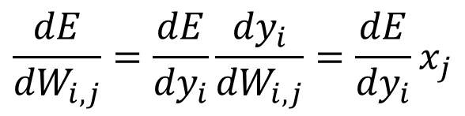
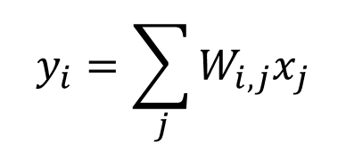
Detail
y₁
y₂
y₃
…
W_{1,<j>}
W_{2,<j>}
W_{3,<j>}
…
x₁
x₂
x₃
x₄
…
=
Computed from previous layer
$$y_{i}=\sum_{j}{W_{i,j}x_{j}}$$
$$\frac{dE}{{dW}_{i,j}}=\frac{dE}{{dy}_{i}}\frac{{dy}_{i}}{{dW}_{i,j}}=\frac{dE}{{dy}_{i}}x_{j}$$
Need input to this layer

Slide 18
Batched Stochastic Gradient Descent
A training epoch:
  Set Δϴ = 0
  For each labeled image:
    Read data to initialize input layer
    Evaluate network to get y (forward)
    Compare with target label t to get error E
    Backpropagate error derivative to get parameter updates
    Accumulate parameter updates into Δϴ
  ϴ_{i+1} = ϴ_{i} - εΔϴ
Aggregate gradient update most accurately reflects true gradient

Slide 19
Mini-batch Stochastic Gradient
For each batch in training set
  For each labeled image in batch:
    Read data to initialize input layer
    Evaluate network to get y (forward)
    Compare with target label t to get error E
    Backpropagate error derivative to get parameter updates
    Accumulate parameter updates into Δϴ
  ϴ_{i+1} = ϴ_{i} - εΔϴ
Balance between accuracy of gradient estimation and parallelism

Slide 20
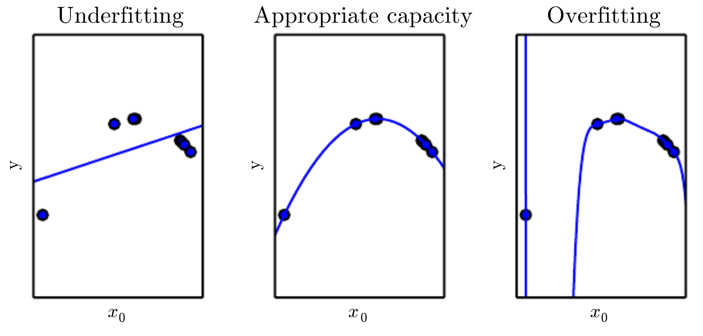
When is training done? (1)

Slide 21
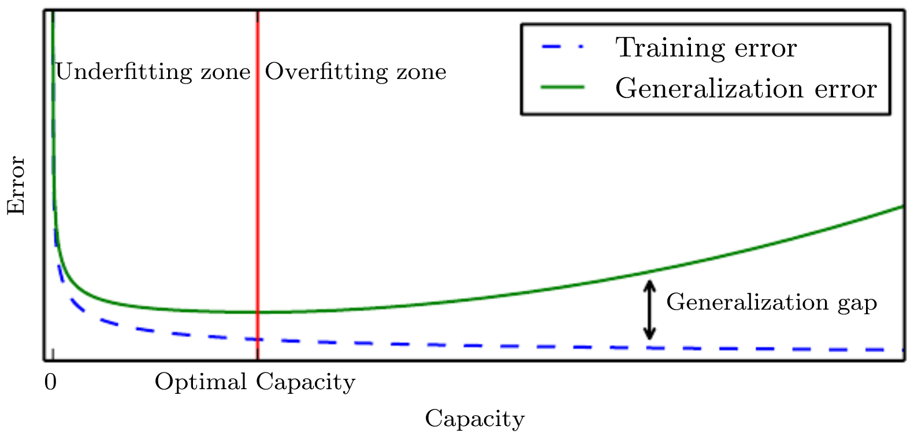
When is training done? (2)
Split dataset into training and test
Generatlization error: difference between training and test error

Slide 22
No Free Lunch Theorem
Every classification algorithm has the same error rate when classifying previously unobserved inputs when averaged over all possible input-generating distributions.
Even neural networks must be tuned for specific tasks

Slide 23
Summary (1)
Classification:
  f : R^{n} → {1, …, k},
  y = f(x, ϴ)
Current ML work driven by cheap compute, lots of available data
Perceptron as a trivial deep network
  y = sign(W • x + b)
Forward for inference, backward for training

Slide 24
Summary (2)
Chain rule to compute parameter updates
Stochastic gradient descent for training

