Slide 1
ECE408/CS483/CSE408 Fall 2017
Convolutional Neural Networks
Carl Pearson
pearson@Illinois.edu

Slide 2
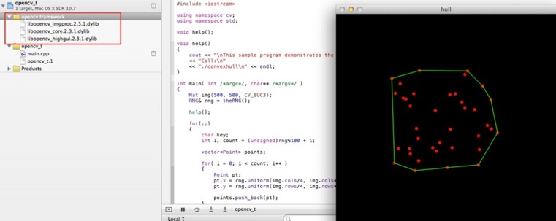
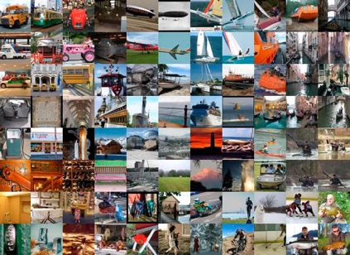
Deep Learning in Computer Vision

Slide 3
MLP for an Image
Consider a 250 x 250 image
  Vectorize the 2D image to a 1D vector as input feature
  Each hidden node would requires 250x250 weights ~ 62,500
  How about multiple hidden layer? Bigger image?
  Too many weights, computational and memory expensive
Traditional feature detection in image processing
  Filters → Convolution kernels
  Can we use it in neural networks?

Slide 4
Y
2-D Convolution
1
2
3
4
5
2
3
4
5
6
X
3
4
321
6
7
1
2
3
4
5
6
7
4
5
6
7
8
2
3
4
5
6
7
8
5
6
7
8
5
3
4
5
6
7
8
9
4
5
6
7
8
5
6
5
6
7
8
5
6
7
6
7
8
9
0
1
2
1
4
9
8
5
7
8
9
0
1
2
3
W
4
9
16
15
12
1
2
3
2
1
9
16
25
24
21
2
3
4
3
2
8
15
24
21
16
3
4
5
4
3
5
12
21
16
5
2
3
4
3
2
1
2
3
2
1

Slide 5
Convolution vs Fully-Connected
+
b
+
…
w_{0,0}
w_{0,1}
W₀
W₁
…
w_{1,0}
W₅
…
…
…
x_{0,0}
x_{0,1}
x₀
x₁
…
…
x_{1,0}
…
x₅
…

Slide 6
Applicability of Convolution
Fixed-size inputs
Variably-sized inputs
  Varying observations of the same kind of thing
    Audio recording of different lengths
    Image with more/fewer pixels

Slide 7
Example Convolution Inputs
 | Single-channel | Multi-channel
1-D | Audio waveform | Skeleton animation data: 1-D joint angles for each join
2-D | Fourier-transformed audio data Convolve frequency axis: invariant to frequency shifts Convolve time axis: invariant to shifts in time | Color image data: 2-D data for R,G,B channels
3-D | Volumetric data, e.g. medical imaging | Color video: 2-D data across 1-D time for R,G,B channels
Deeplearningbook.org, ch 9, p 355

Slide 8
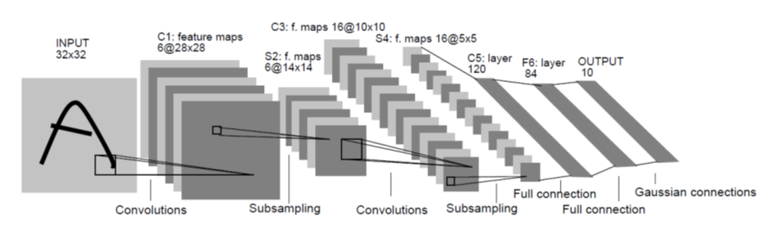
LeNet-5:CNN for hand-written digit recognition

Slide 9
Anatomy of a Convolution Layer
Input features/channels
A inputs (N₁ × N₂)
Convolution Layer
B convolution kernels (K₁ × K₂)
Output Features/channels
A × B outputs
(N₁ – K₁/2) × (N₂ – K₂/2)

Slide 10
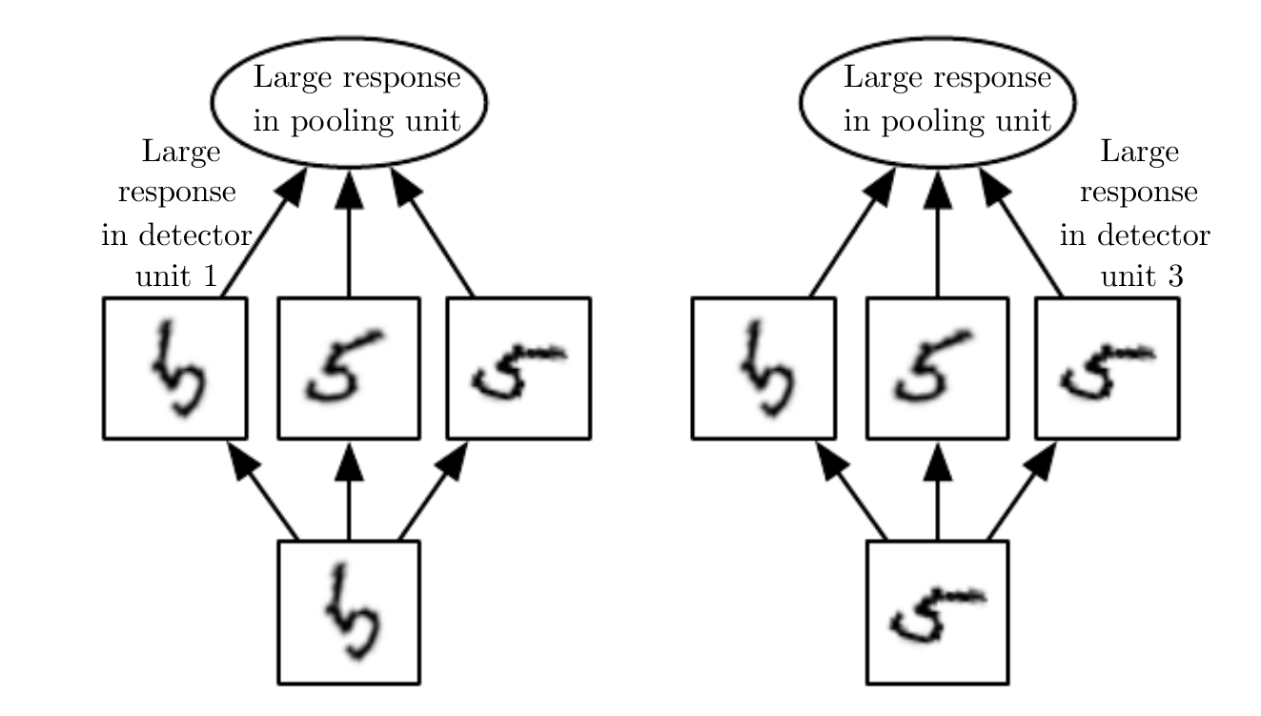
Aside: 2-D Pooling
A subsampling layer
  Sometimes with bias and non-linearity built in
Common types: max, average, L² norm, weighted average
Helps make representation invariant to small translations in the input

Slide 11
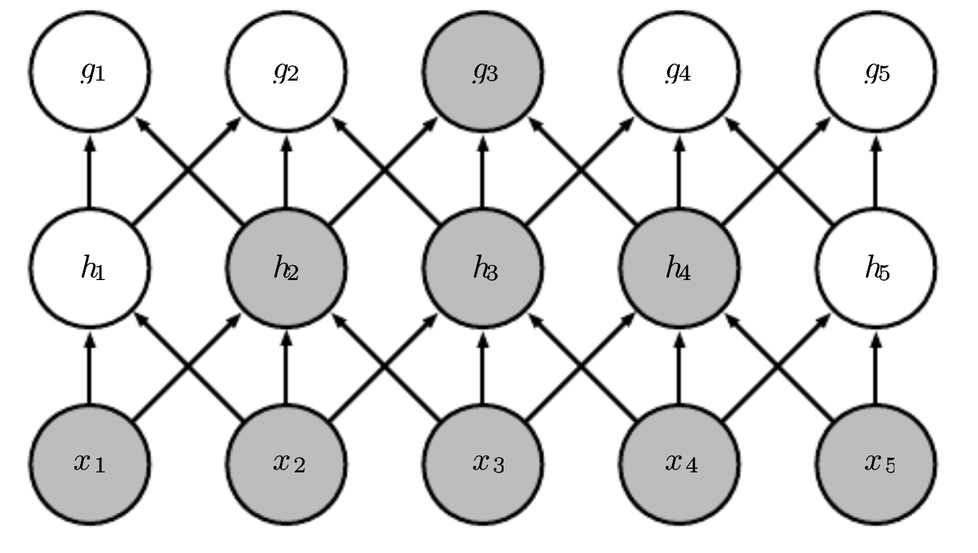
Why Convolution (1)
Sparse interactions
  Meaningful features in small spatial regions
  Need fewer parameters (less storage, better statistical characteristics, faster training)
  Need multiple layers for wide receptive field

Slide 12
Why Convolution (2)
Parameter sharing
  Kernel is reused when computing layer output
Equivariant Representations
  If input is translated, output is translated the same way
  Map of where features appear in input
y_{0,0}
y_{0,1}
…
y_{1,0}
+
+
w_{0,0}
w_{0,1}
w_{1,0}
x_{0,0}
x_{0,1}
…
x_{1,0}

Slide 13
Convolution
2-D Matrix
Y = W ⊗ X
Kernel smaller than input: smaller receptive field
Fewer Weights
MLP
Vector
Y = w x + b
Maximum receptive field
More weights

Slide 14
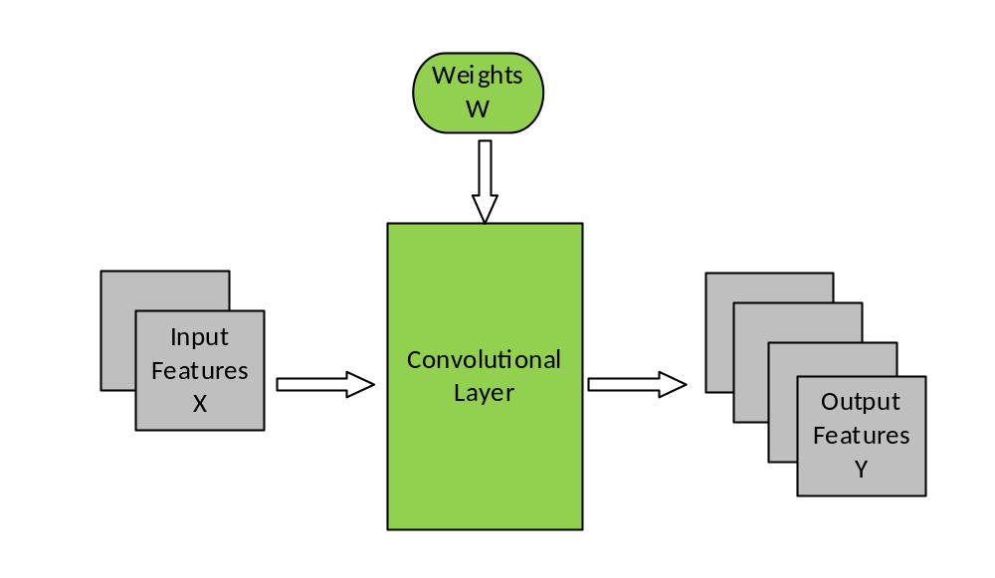
Forward Propagation

Slide 15
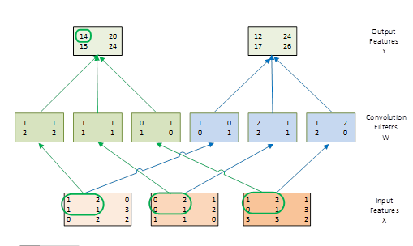
Example of the Forward Path of a Convolution Layer

Slide 16
Sequential Code: Forward Convolutional Layer
void convLayer_forward(int B, int M, int C, int H, int W, int K, float* X, float* W, float* Y) {
int H_out = H – K + 1;
int W_out = W – K + 1;
for (int b = 0; b < B; ++b) // for each image in batch
for(int m = 0; m < M; m++) // for each output feature map
for(int h = 0; h < H_out; h++) // for each output element
for(int w = 0; w < W_out; w++) {
Y[m, h, w] = 0;
for(int c = 0; c < C; c++) // sum over all input feature maps
for(int p = 0; p < K; p++) // KxK filter
for(int q = 0; q < K; q++)
Y[b, m, h, w] += X[b, c, h + p, w + q] * W[m, c, p, q];
}
}

Slide 17
Sequential Code: Forward Pooling Layer
void poolingLayer_forward(int B, int M, int H, int W, int K, float* Y, float* S) {
for (int b = 0; b < B; ++b) // for each image in batch
for (int m = 0; m < M; ++m) // for each output feature maps
for (int h = 0; x < H/K; ++h) // for each output element
for (int w = 0; y < W/K; ++y) {
S[m, x, y] = 0.;
for (int p = 0; p < K; ++p) // loop over KxK input samples
for (int q = 0; q < K; ++q)
S[b, m, h, w] += Y[b, m, K*x + p, K*y + q] /(K*K);
}
S[b, m, h, w] = sigmoid(S[b, m, h, w] + b[m]) // bias, non-linearity
}

Slide 18
Function to generate “unrolled” X
void unroll(int B, int C, int H, int W, int K, float* X, float* X_unroll) {
int H_out = H – K + 1;
int W_out = W – K + 1;
for (int b = 0; b < B; ++b)
for (int c = 0; c < C; ++c) {
int w_base = c * (K*K);
for (int p = 0; p < K; ++p)
for (int q = 0; q < K; ++q) {
for (int h = 0; h < H_out; ++h)
for (int w = 0; w < W_out; ++w) {
int w_unroll = w_base + p * K + q;
int h_unroll = h * W_out + w;
X_unroll[b, h_unroll, w_unroll] = X[b, c, h + p, w + q];
}
}
}

Slide 19
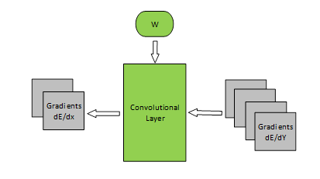
Backpropagation

Slide 20
Calculating dE/dX
void convLayer_backward_dgrad(int B, int M, int C, int H, int W, int K, float *dE_dY, float *W, float *dE_dX) {
int H_out = H – K + 1;
int W_out = W – K + 1;
for (int b = 0; b < B; ++b) {
for (int c = 0; c < C; ++c)
for (int h = 0; h < H; ++h)
for (int w = 0; w < W; ++w)
dE_dX[b, c, h, w] = 0;
for (int m = 0; m < M; ++m)
for (int h = 0; h < H_out; ++h)
for (int w = 0; w < W_out; ++w)
for (int c = 0; c < C; ++c)
for (int p = 0; p < K; p)
for (int q = 0; q < K; ++q)
dE_dX[b, c, h + p, w + q] += dE_dY[b, m, h, w] * W[m, c, p, q];
}
}

Slide 21
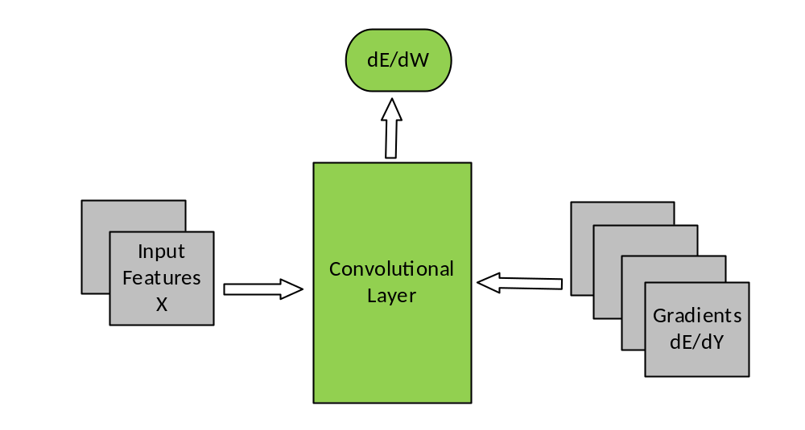
Backpropagation

Slide 22
Calculating dE/dW
void convLayer_backward_wgrad(int B, int M, int C, int H, int W, int K, float *dE_dY, float *X, float *dE_dW) {
const int H_out = H – K + 1;
const int W_out = W – K + 1;
for (int b = 0; b < B; ++b) {
for(int m = 0; m < M; ++m)
for(int c = 0; c < C; ++c)
for(int p = 0; p < K; ++p)
for(int q = 0; q < K; ++q)
dE_dW[b, m, c, p, q] = 0;
for(int m = 0; m < M; ++m)
for(int h = 0; h < H_out; ++h)
for(int w = 0; w < W_out; ++w)
for(int c = 0; c < C; ++c)
for(int p = 0; p < K; ++p)
for(int q = 0; q < K; ++q)
dE_dW[b, m, c, p, q] += X[b, c, h + p, w + q] * dE_dY[b, m, c, h, w];
}
}

